Slide 1


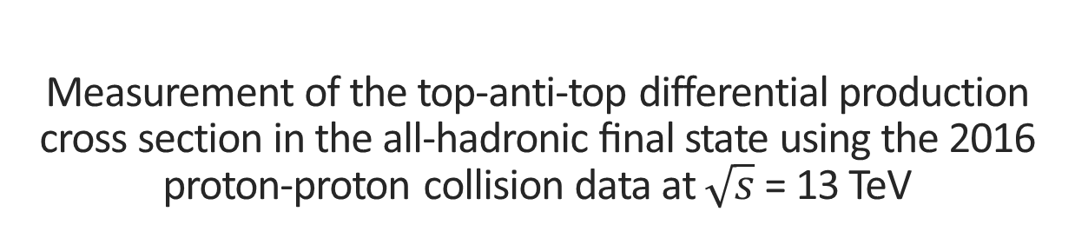
Measurement of the top-anti-top differential production cross section in the all-hadronic ﬁnal state using the 2016 proton-proton collision data at $\sqrt{s}$ = 13 TeV
National Technical University of Athens
Conference on Recent Developments in High Energy Physics and Cosmology
K. Kousouris, G. Tsipolitis, G. Bakas (NTUA), G.Paspalaki (NCSR Demokritos), I.Papakrivopoulos, A. Castro, F. Celli (INFN Bologna), P. Kumar Mal (NISER)

Slide 2
Contents
Top Quark
Boosted Jets
CMS Experiment
Analysis
Overview

Slide 3
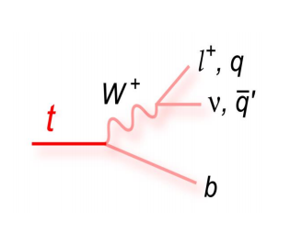
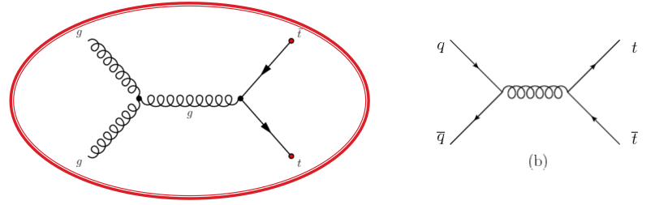
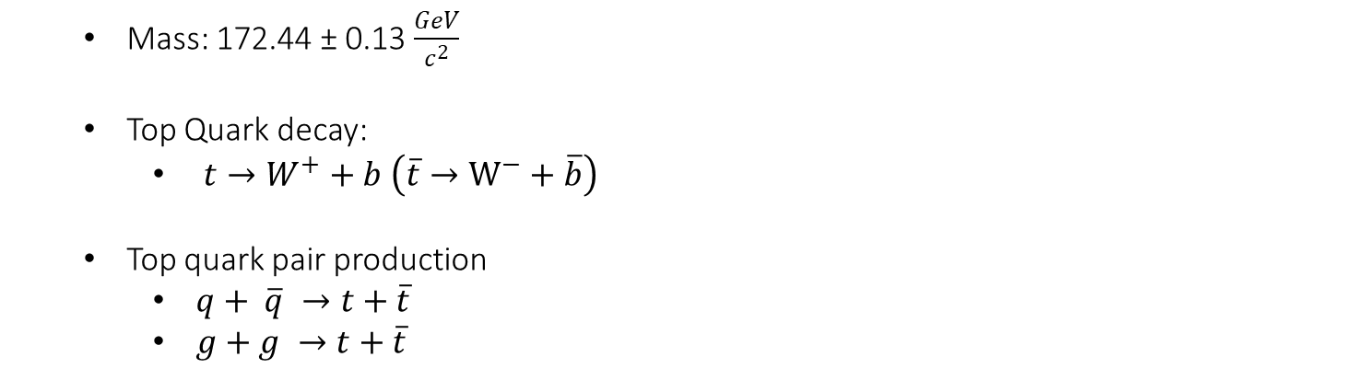
Top Quark
Mass: 172.44 ± 0.13 $\frac{GeV}{c^{2}}$
Top Quark decay:
$t→W^{+}+b \left(\overline{t}→W^{−}+\overline{b}\right)$
Top quark pair production
$q+ \overline{q} →t+\overline{t}$
$g+g →t+\overline{t}$
Gluon Fusion is dominant at LHC

Slide 4
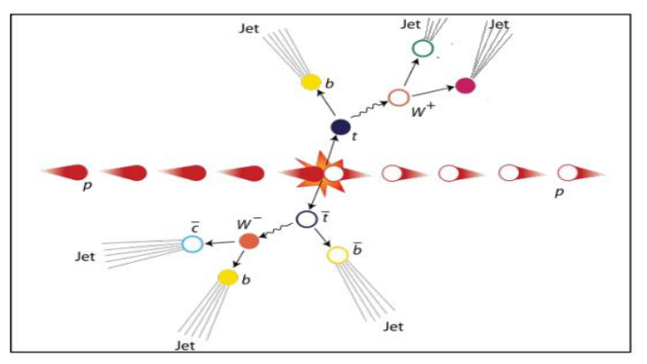
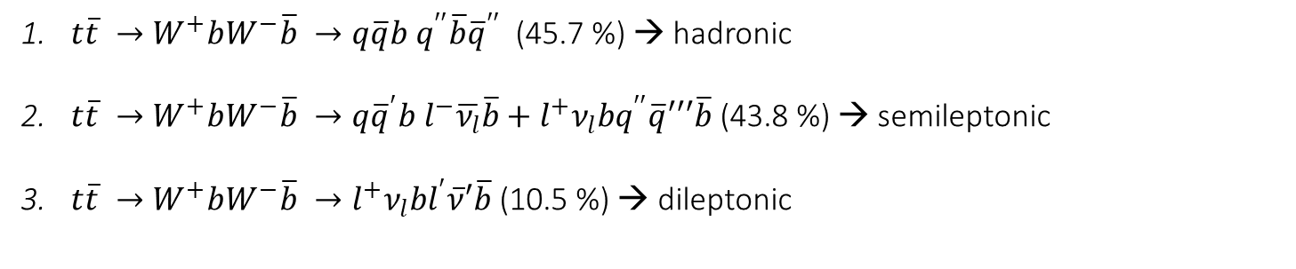
Top AntiTop system decay
$t\overline{t} →W^{+}bW^{−}\overline{b} →q\overline{q}b q^{′′}\overline{b}{\overline{q}}^{′′}$ (45.7 %) → hadronic
$t\overline{t} →W^{+}bW^{−}\overline{b} →q{\overline{q}}^{′}b l^{−}\overline{ν_{l}}\overline{b}+l^{+}ν_{l}bq^{′′}\overline{q}′′′\overline{b}$ (43.8 %) → semileptonic
$t\overline{t} →W^{+}bW^{−}\overline{b} →l^{+}ν_{l}bl^{′}\overline{ν}′\overline{b}$(10.5 %) → dileptonic

Slide 5
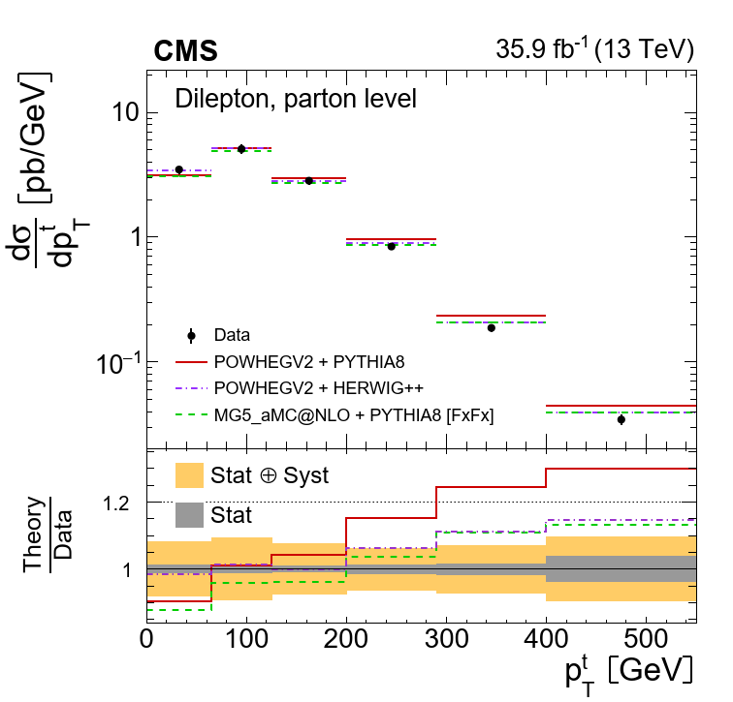
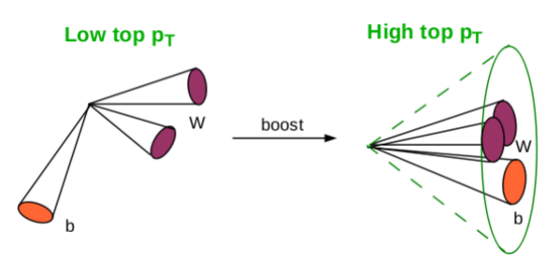
Boosted Jets
Boosted Jets are jets with high p_{T} ( > 400 GeV)
Aim is the reconstruction of two big jets that contain the decay products of the top-antitop quark pair decay
Motivation
With resolved hypothesis we measure the top pair cross section up to ~500GeV
There is an interesting discrepancy with theory (p_{T} slope)
In order to see what happens in bigger p_{T} ‘s → boosted
Why Boosted jets?
Single “fat” jet: No combinatorial background
At high top p_{T} the hadronic decay is easier to reconstruct than the leptonic
In order to identify boosted jets
Use of sophisticated reconstruction techniques to identify the substructure within the jet
SoftDrop technique to eliminate soft contributions

Slide 6
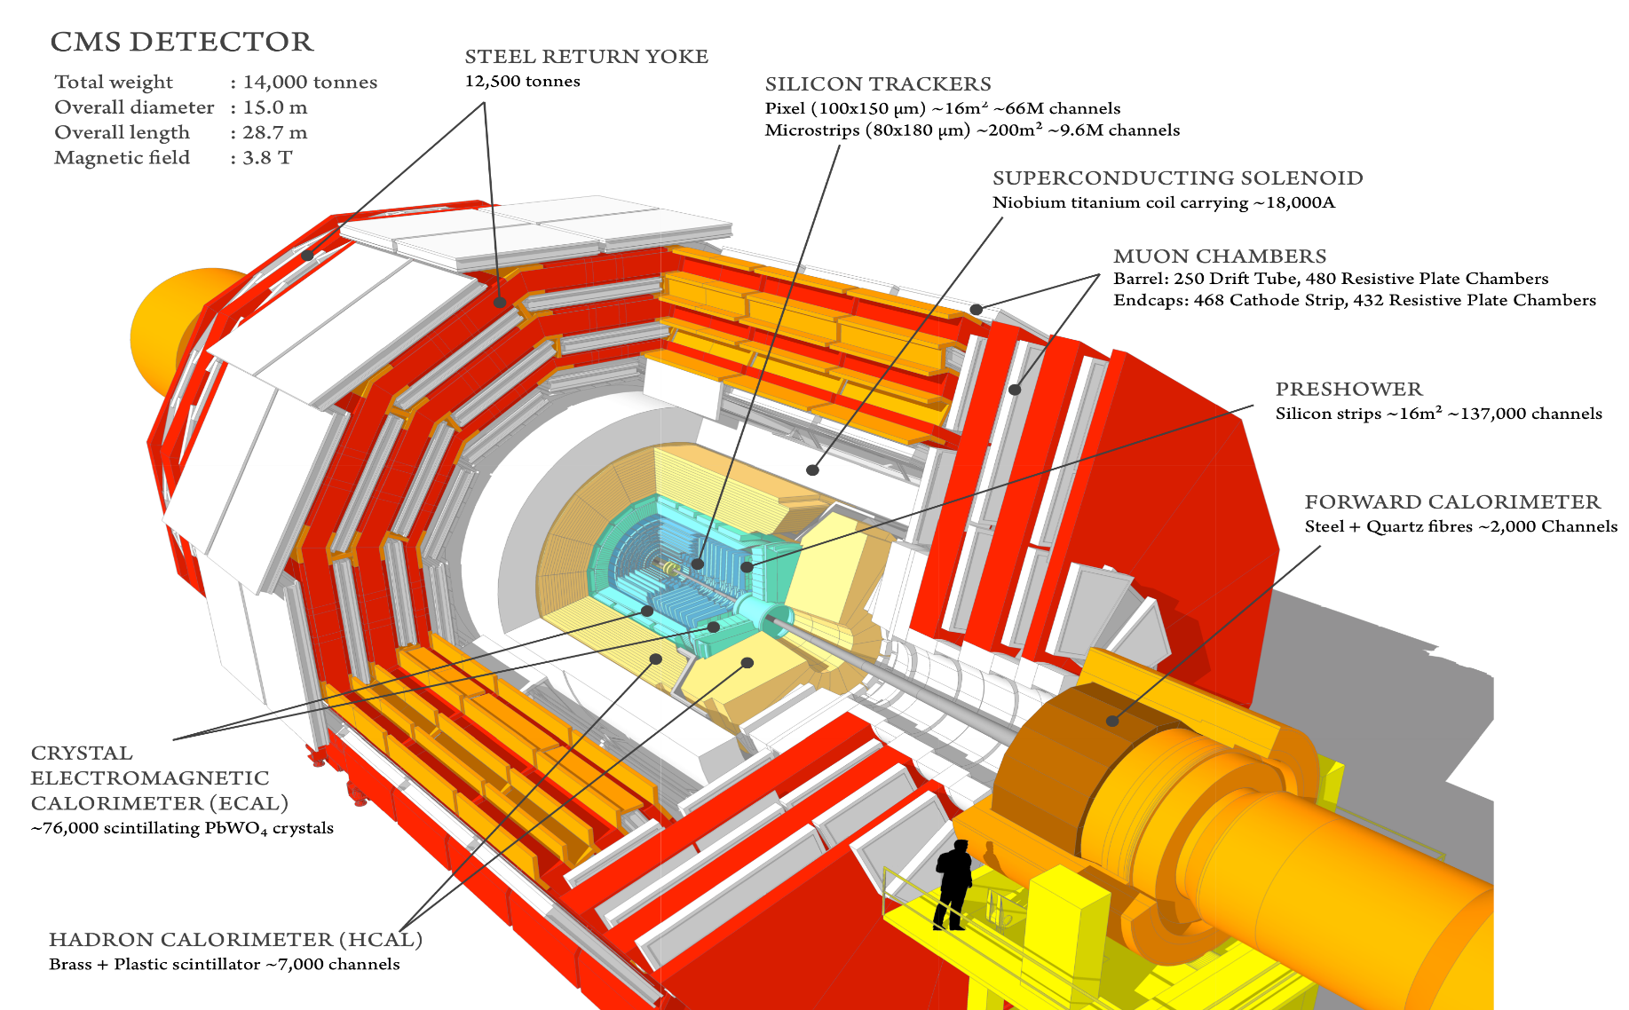
Compact Muon Solenoid Experiment
CMS is a general purpose detector and its goal is to investigate a wide range of physics

Slide 7
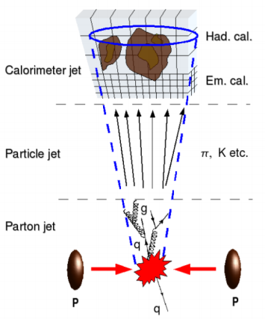
Analysis Overview
2016 dataset
Very well understood (calibrations, scale factors, etc)
Trigger:
L1: Single Jet with p_{T} > 200GeV
HLT: two AK8 jets, b tagged
Selection:
two AK8 jets with p_{T} > 400 GeV
tagged ttbar event with MVA that uses the jet substructure variables as inputs
categories based on subjet b-tagging:
0-btag: control region
2-btag: signal region
Background
QCD dominant: taken from data
Single Top, W/Z +jets are negligible
Deliverables
Differential cross sections in parton level (absolute and normalized)
Two observables: top p_{T} , ttbar system mass

Slide 8
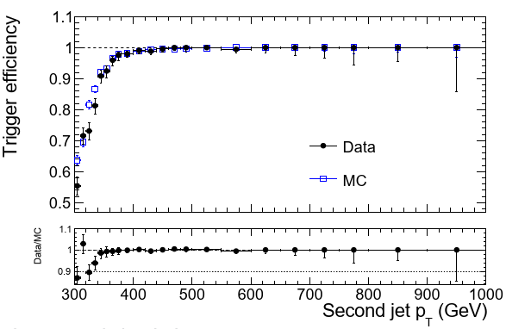
Trigger
Level 1 Trigger:
L1 SingleJet180 OR L1 SingleJet200
High Level Trigger:
Signal path: HLT_AK8DiPFJet280_200_TrimMass30_BTagCSV p20
Aims to capture the decay products of boosted top pair
p_{T,1} > 280 GeV and p_{T,2} > 200 GeV
Jet mass > 30 GeV
At least one of the 2 jets should be b-tagged
Efficiency measured wrt orthogonal muon trigger
Control path: HLT_AK8DiPFJet280_200_TrimMass30
Same kinematics, no HLT b-tagging
Work in progress
Analysis Region
Trigger Efficiency vs Subleading jet p_{T} (GeV)

Slide 9
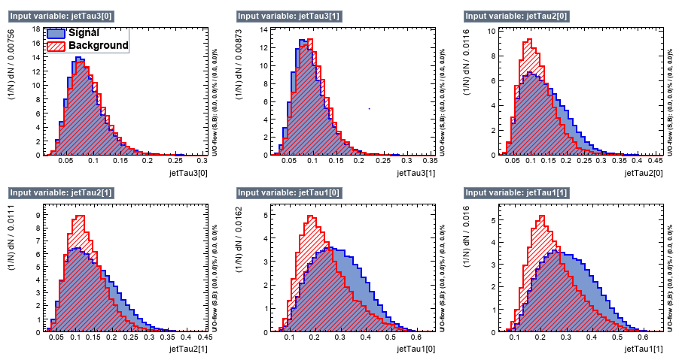
Multivariate Discriminant Analysis(variables)
Work in progress
Work in progress
Work in progress
Work in progress
Work in progress
Work in progress
Discriminating variables used for separation of the $t\overline{t}$ from the QCD events

Slide 10
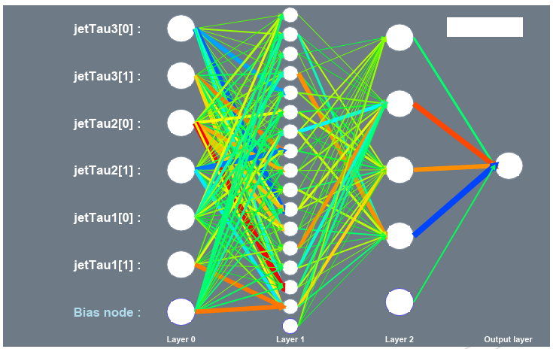
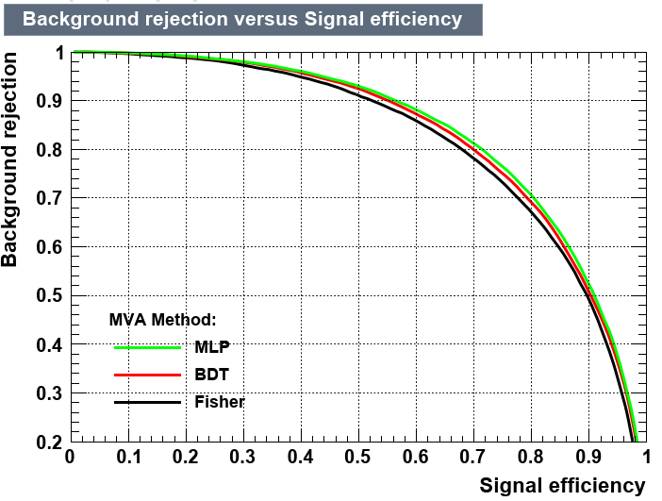
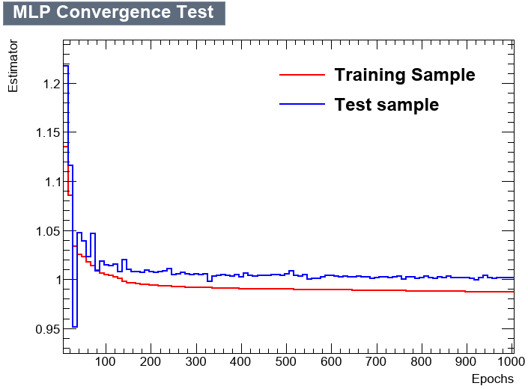
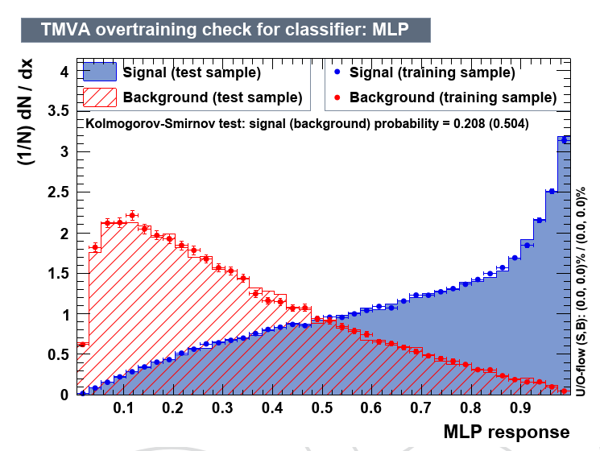
Multivariate Discriminant Analysis (training)
Work in progress
Work in progress
Work in progress

Slide 11
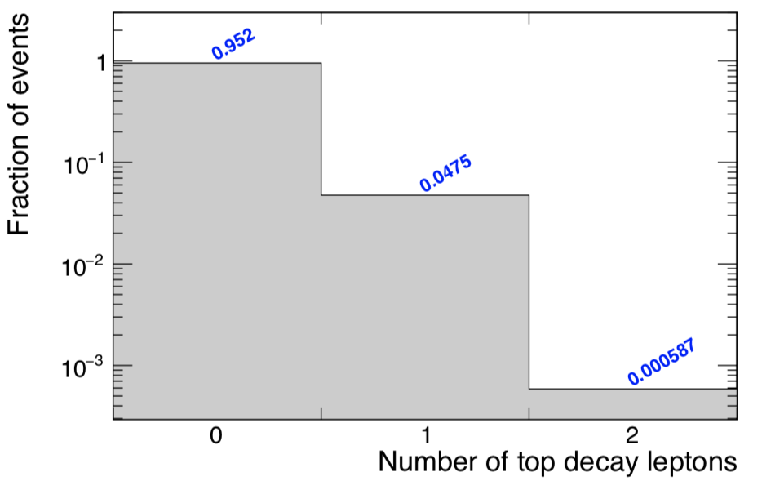
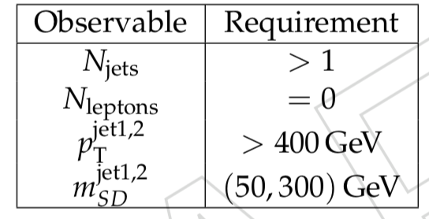
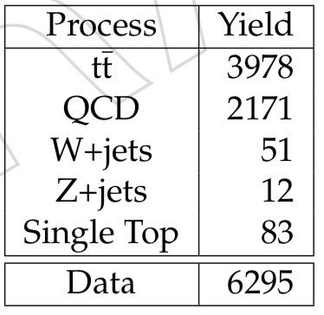
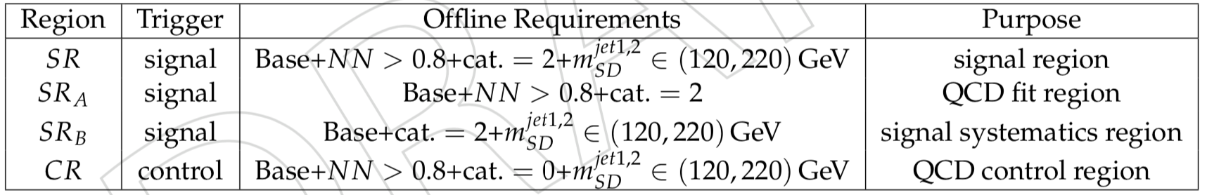
Selection
Baseline Selection
Work in progress
Selected jets: AK8 PF+CHS
From signal selection almost 95% of the decays are hadronic
Table: Selection requirements per analysis region

Slide 12
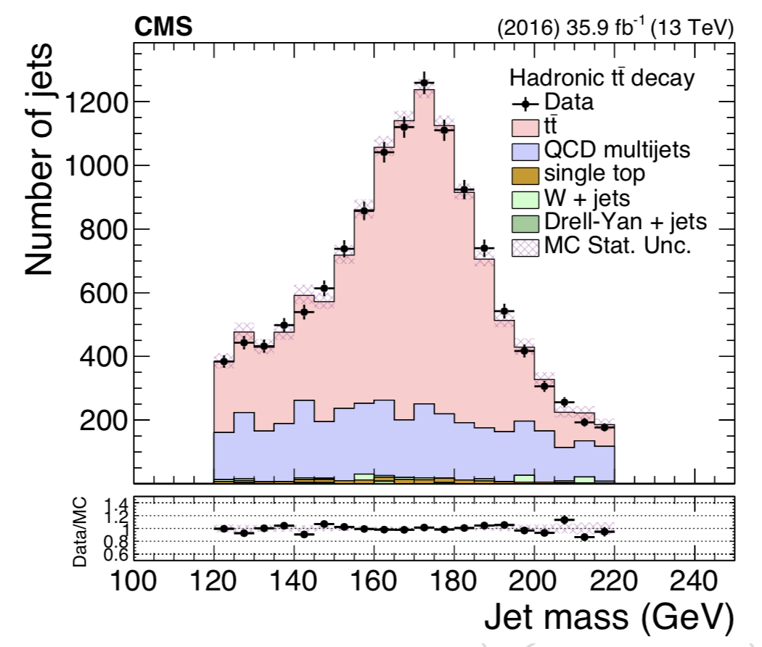
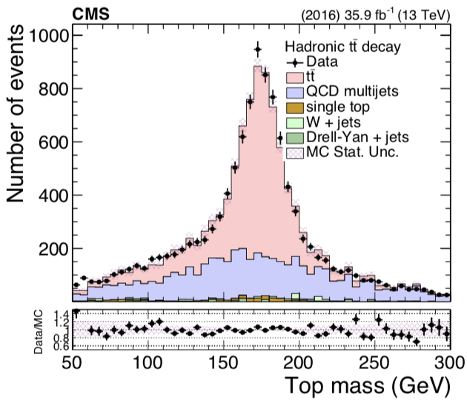
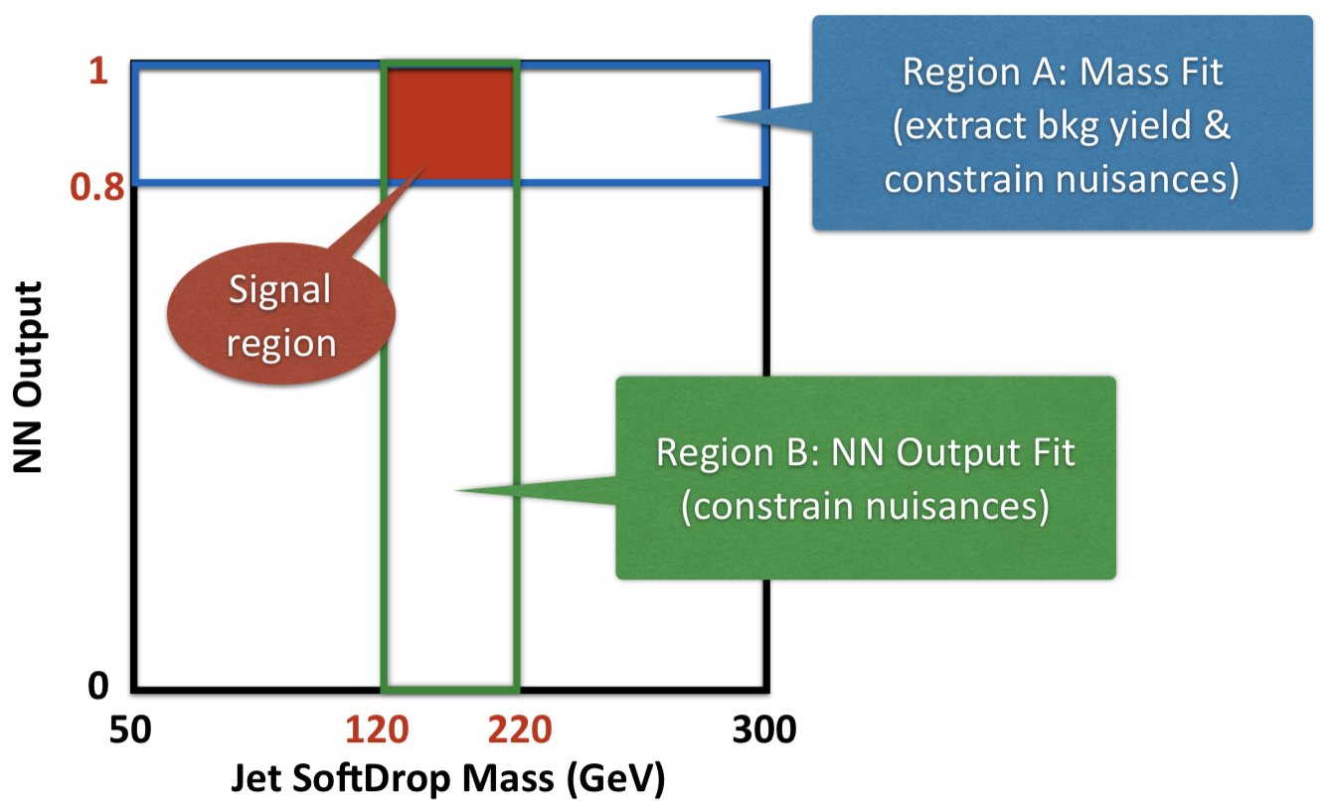
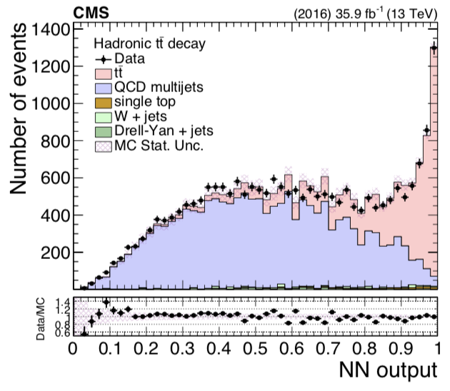
Analysis Regions
Work in progress
Work in progress
Work in progress

Slide 13
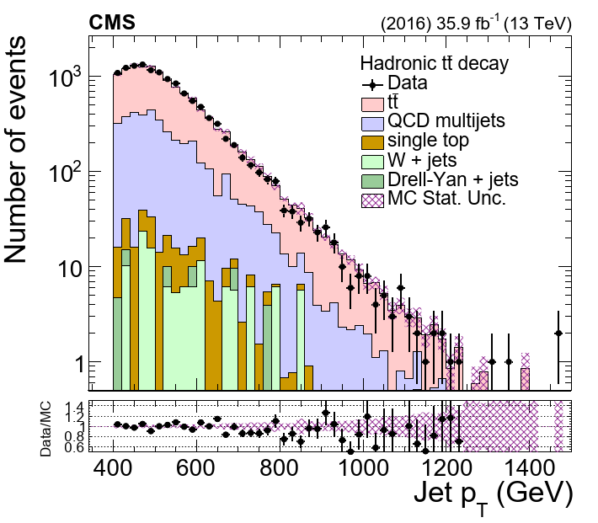
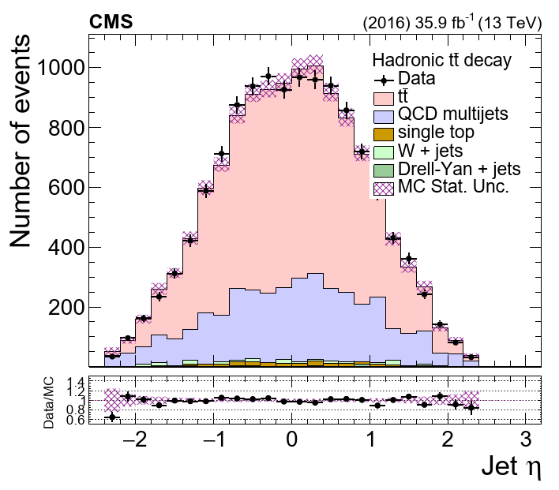
Data vs MC: Top jet Kinematics
Work in progress
Work in progress

Slide 14
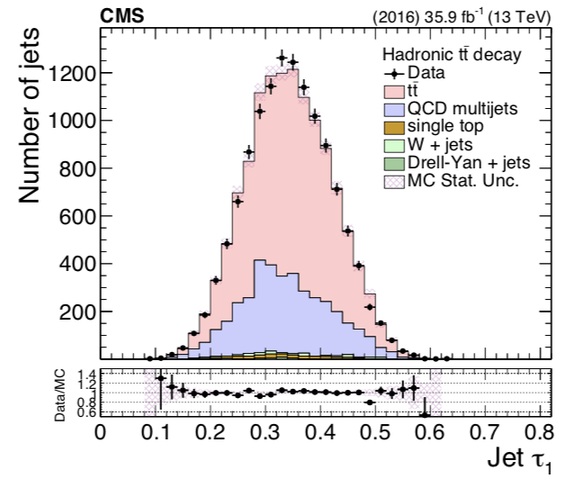
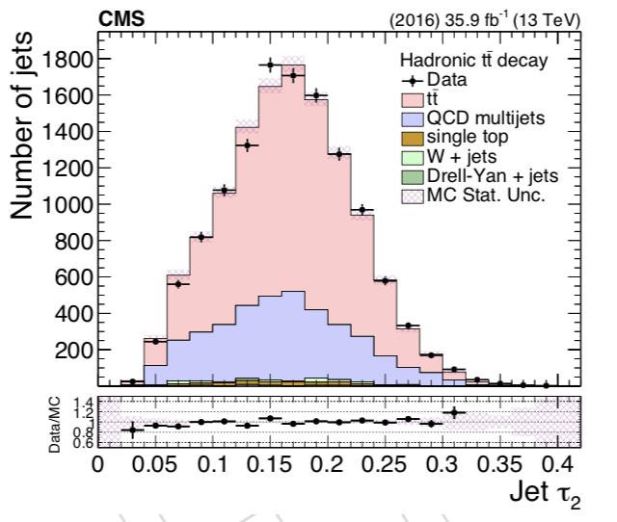
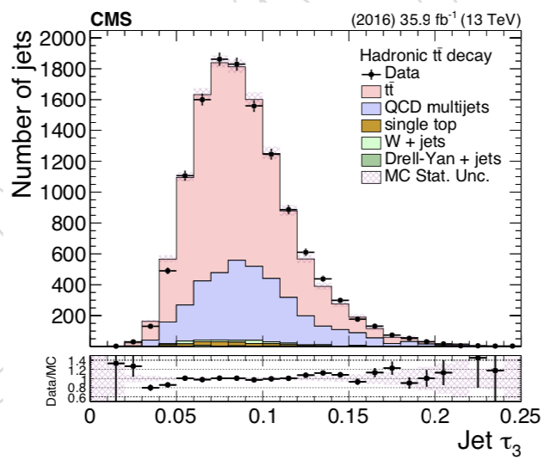
Data vs MC: Substructure Properties
Work in progress
Work in progress
Work in progress

Slide 15
Signal Extraction
Transfer factor from SR_{A} to SR
Bkg Shape Correction
(taken from MC)
Fiducial Yield
$$S_{fid}\left(x_{reco}\right)=D\left(x_{reco}\right) −R_{yield}N_{qcd}C_{bkg}^{shape}Q\left(x_{reco}\right)$$
Data
Bkg Shape
(taken from CR in data)
Bkg Yield
(fit in region SR_{A})

Slide 16
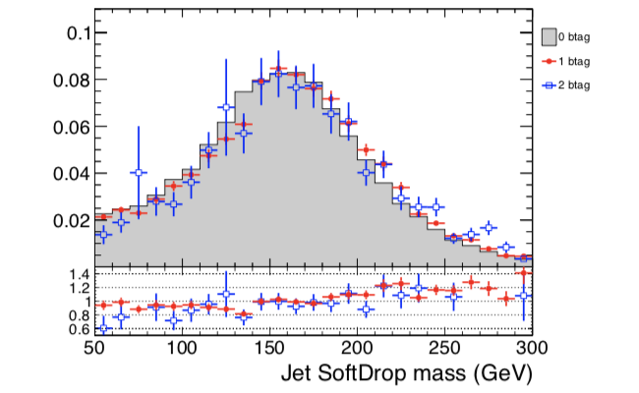
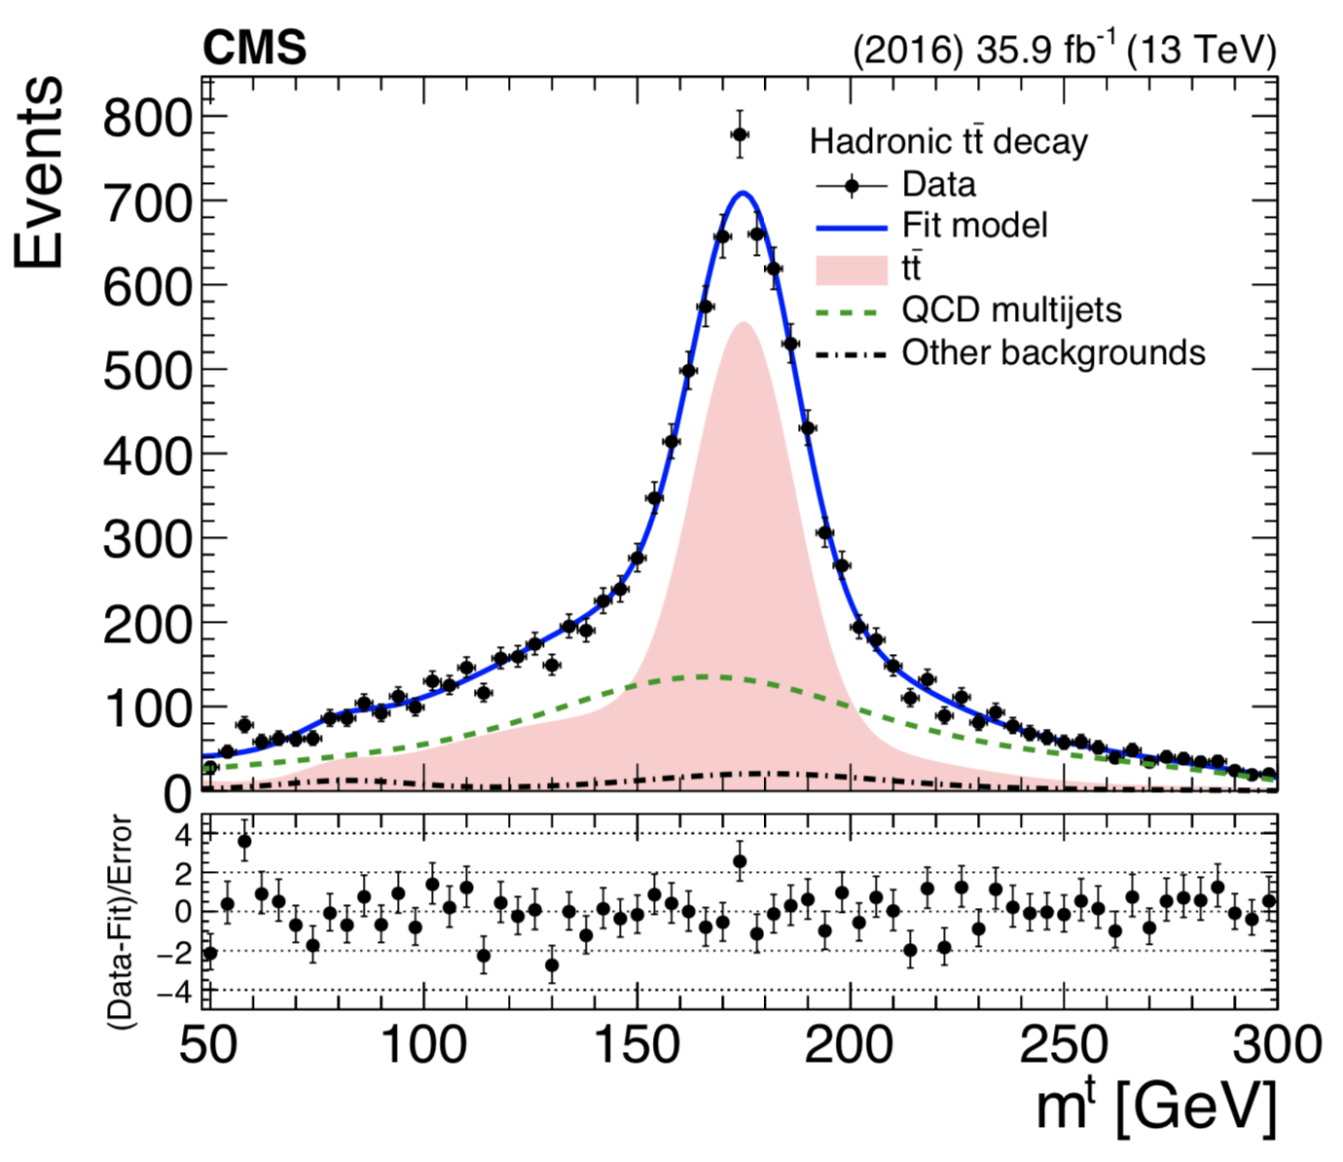
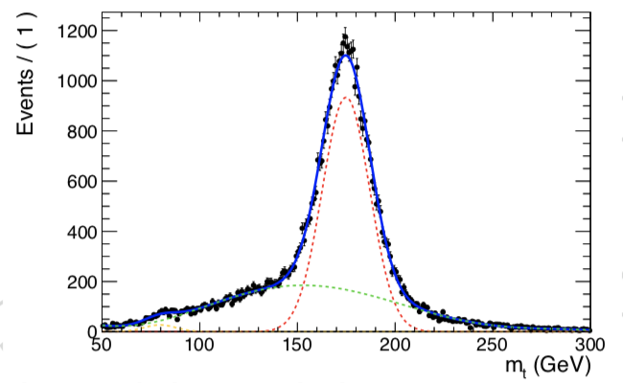
Fit in the SR_{A} Region
Work in progress
Work in progress
Work in progress

Slide 17
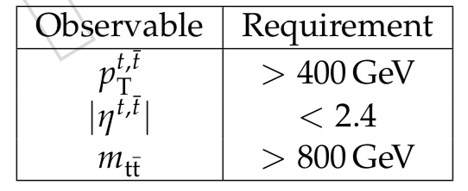
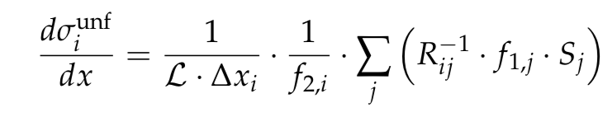
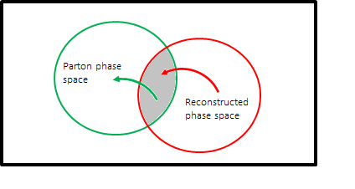
Parton Level
Parton Level selection
Reco and parton over reco
Reco and parton over parton
Migration matrix
Unfolding is done using simple response matrix inversion without regularization

Slide 18
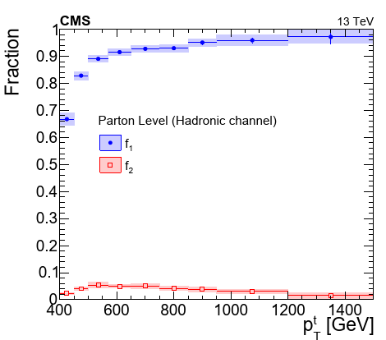
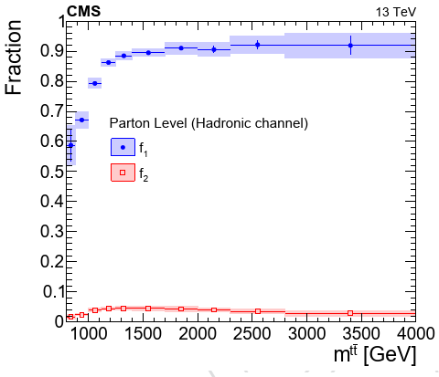
Extrapolation factors for parton level
f₁: fraction of reco events in the reco+parton phase space
Work in progress
Work in progress
f₂: fraction of parton events in the reco+parton phase space

Slide 19
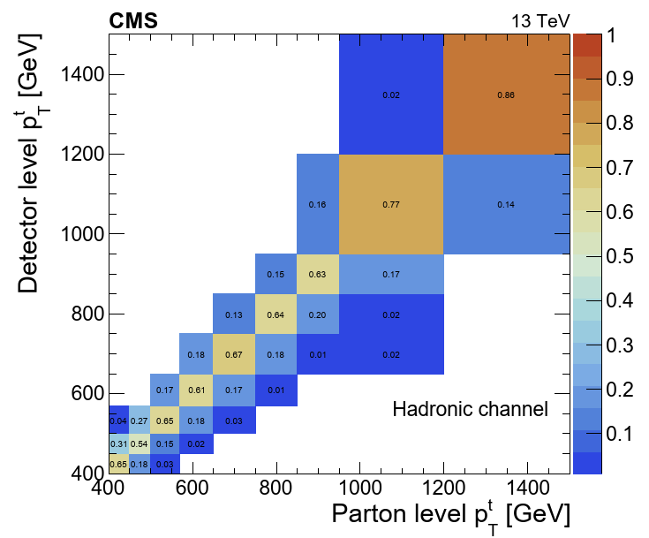
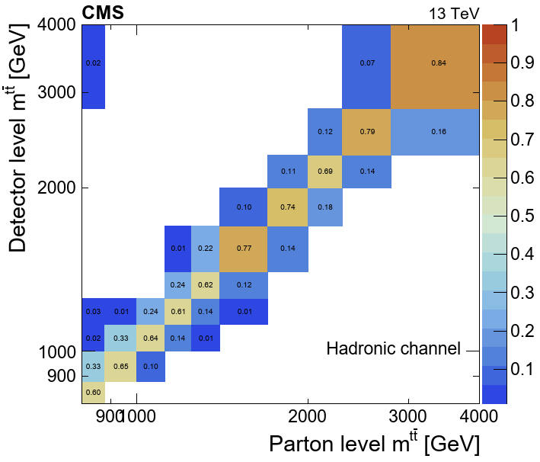
Migration Matrices
Work in progress
Work in progress

Slide 20
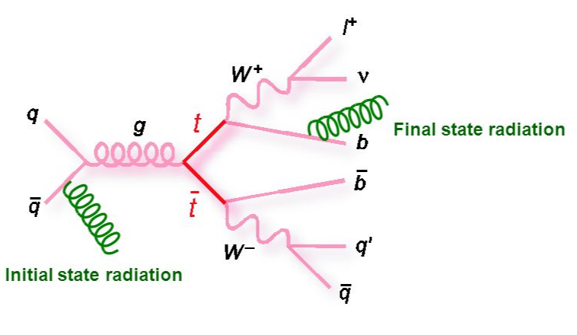
Uncertainties
Experimental:
QCD background prediction
Statistics
Jet Energy Scale
Jet Energy Resolution
B tagging efficiency
Theoretical:
Affect the extrapolation factors (f₁ , f₂) and the migration matrices for the unfolding procedure
ISR (Initial State Radiation)
FSR (Final State Radiation)
CMS tuned set of MC parameters for Pythia 8

Slide 21
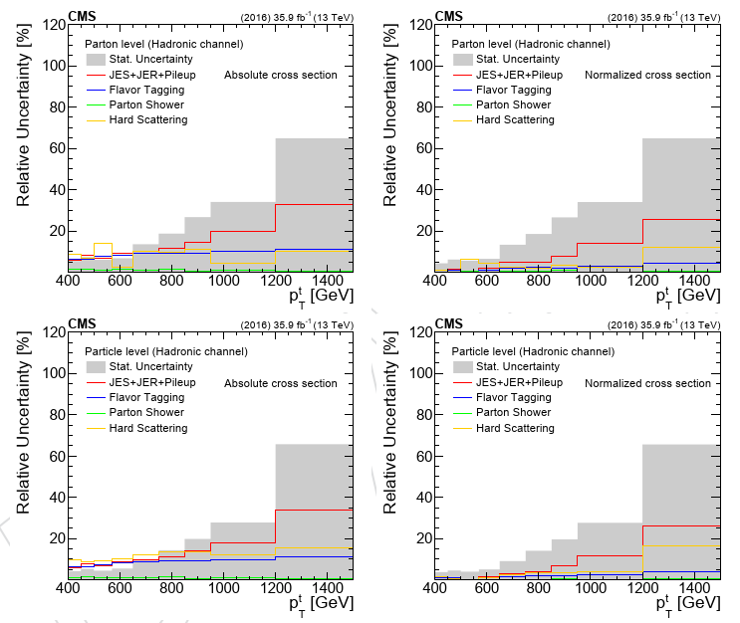
Uncertainties
Work in progress
Work in progress
Uncertainties for the parton and particle level measurements
(normalized)
Uncertainties for the parton and particle level measurements
(absolute)
Work in progress
Work in progress

Slide 22
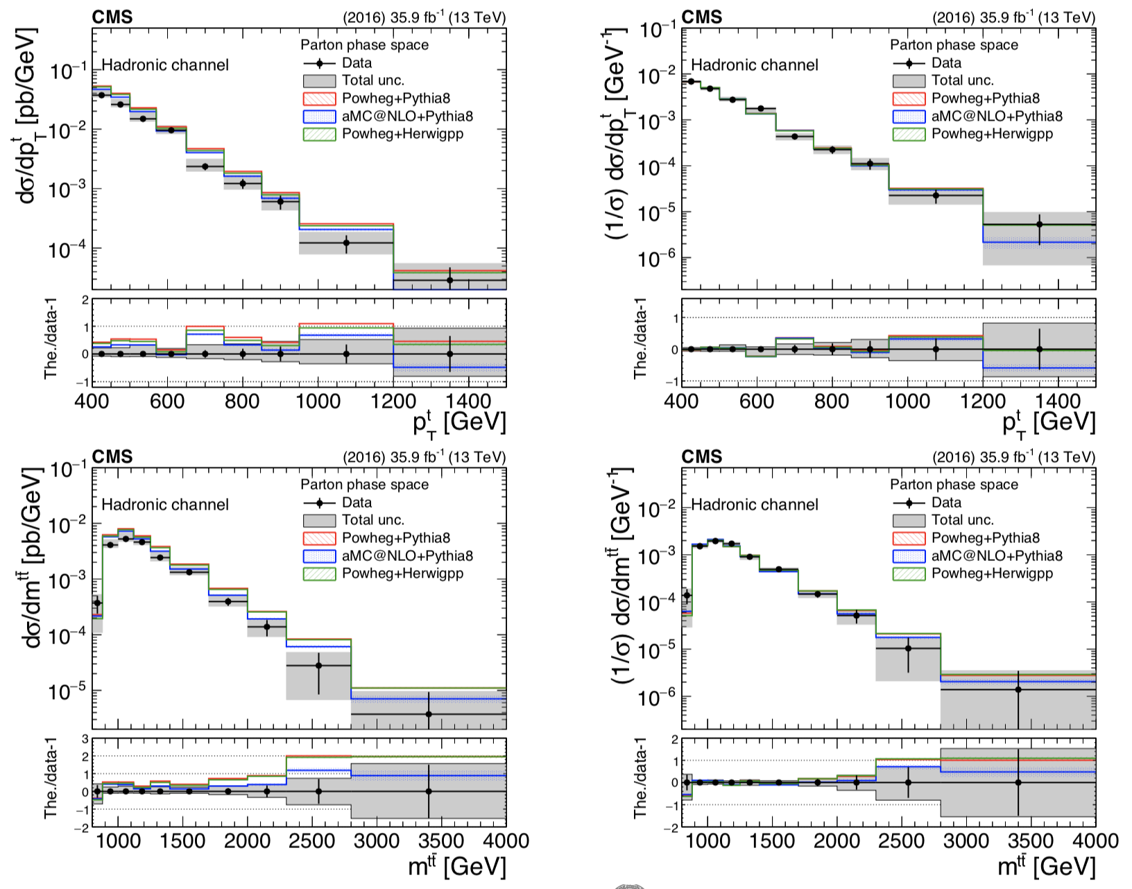
Results for Parton Measurement (top p_{T} , m_{tt})
Work in progress
Work in progress
Work in progress
Work in progress

Slide 23
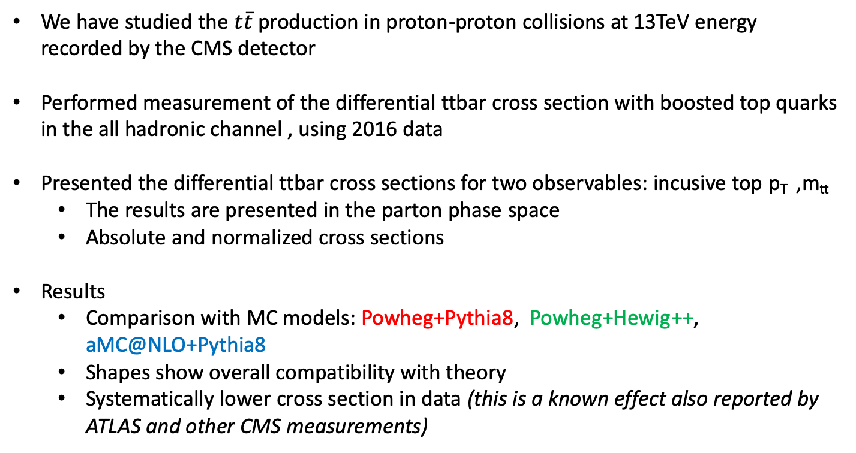
Overview
We have studied the $t\overline{t}$ production in proton-proton collisions at 13TeV energy recorded by the CMS detector
Performed measurement of the differential ttbar cross section with boosted top quarks in the all hadronic channel , using 2016 data
Presented the differential ttbar cross sections for two observables: incusive top p_{T} ,m_{tt}
The results are presented in the parton phase space
Absolute and normalized cross sections
Results
Comparison with MC models: Powheg+Pythia8, Powheg+Hewig++, aMC@NLO+Pythia8
Shapes show overall compatibility with theory
Systematically lower cross section in data (this is a known effect also reported by ATLAS and other CMS measurements)

Slide 24
Thank you for your attention!

Slide 25
BACKUP SLIDES

Slide 26
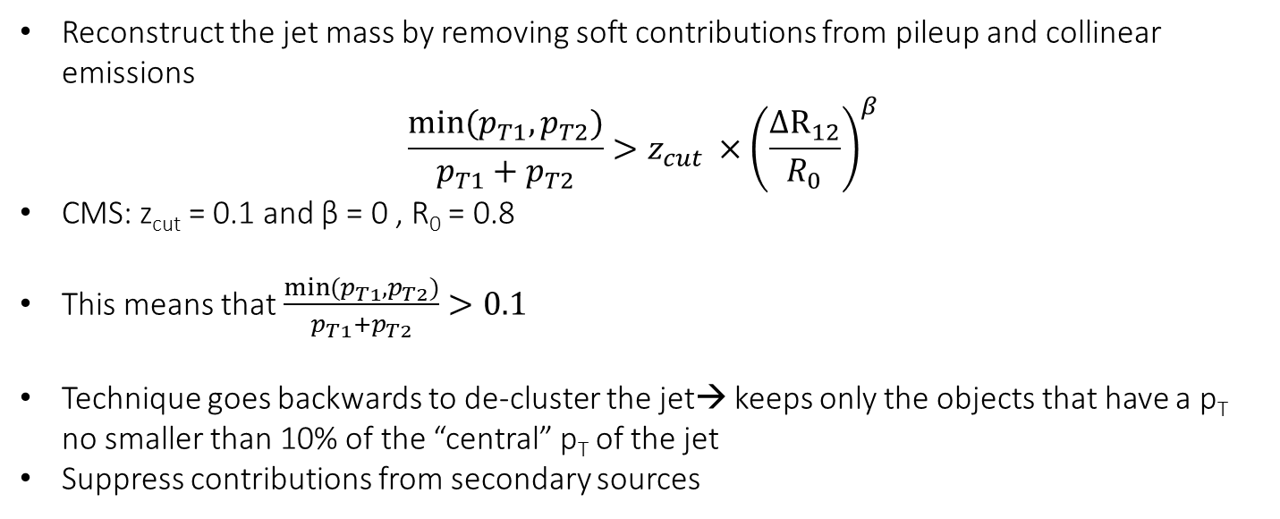
Jet Mass Soft Drop Technique
Reconstruct the jet mass by removing soft contributions from pileup and collinear emissions
$$\frac{min⁡(p_{T1}, p_{T2})}{p_{T1}+p_{T2}}>z_{cut} ×{\left(\frac{ΔR_{12}}{R_{0}}\right)}^{β}$$
CMS: z_{cut} = 0.1 and β = 0 , R₀ = 0.8
This means that $\frac{min⁡(p_{T1}, p_{T2})}{p_{T1}+p_{T2}}>0.1$
Technique goes backwards to de-cluster the jet→ keeps only the objects that have a p_{T} no smaller than 10% of the “central” p_{T} of the jet
Suppress contributions from secondary sources

Slide 27
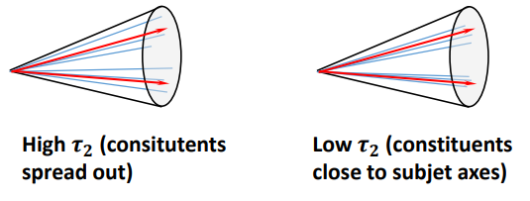
N Subjetiness τ_{N}
The NN combines the τ₁ , τ₂ , τ₃ of the two leading jets, where τ_{Ν} is the subjetiness and N is the number of prong jets
Prong jets are the number of jets that determine the substructure of the boosted jets
The τ_{i} is defined as
$$τ_{i}= \frac{1}{\sum_{k}{p_{T,k}R_{0}}}\sum_{k}{p_{T,k }\min\left(ΔR_{1k }, ΔR_{2k}, …ΔR_{ik}\right)}$$
Where ΔR_{ik} is the angular separation between constituent k and candidate subjet i
R₀ = 0.8 for AK8 clustering
Clusters with exactly N subjets will have small τ_{Ν}
If τ_{Ν} ≃1, cluster most likely has more than N subjets

Slide 28
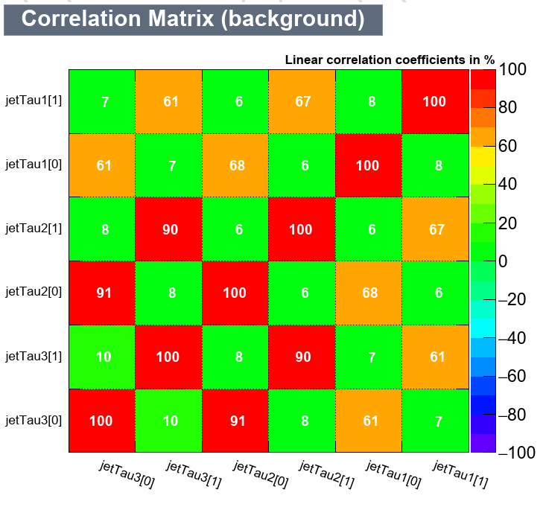
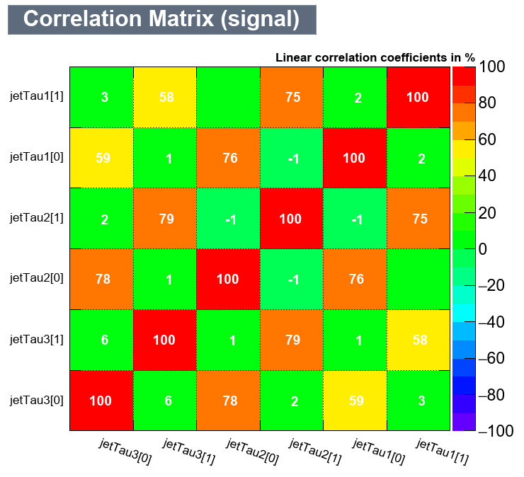
MVA training: Correlation Matrices
Work in progress
Work in progress

Slide 29
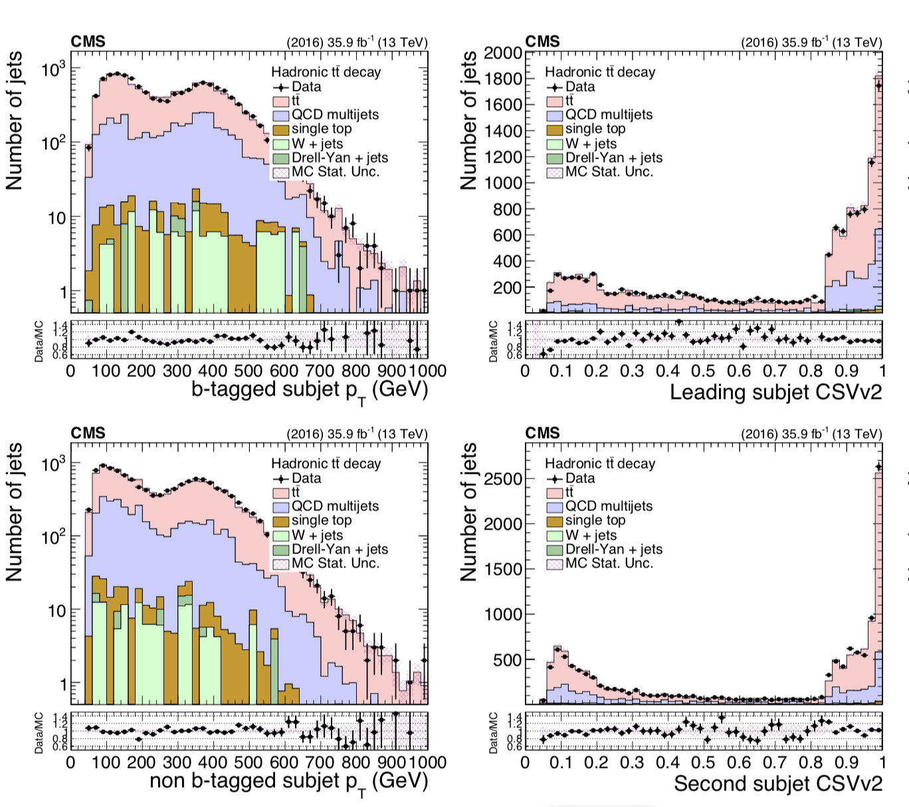
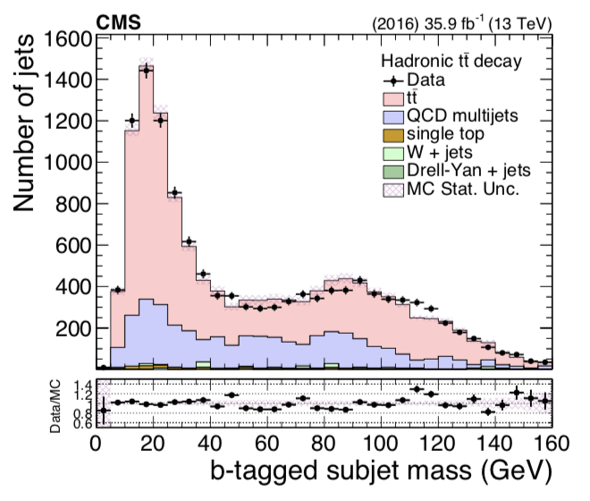
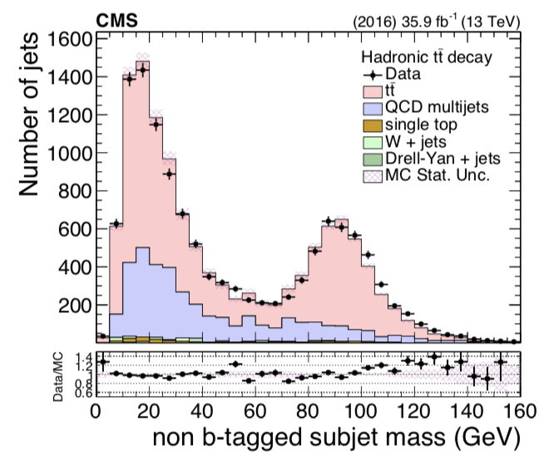
Data vs MC: Subjet Properties
Work in progress
Work in progress
Work in progress
Work in progress
Work in progress
Work in progress

Slide 30



Data vs MC: ttbar Kinematics
Work in progress
Work in progress
Work in progress

Slide 31


Particle Level Selection
Reco and particle over reco
Particle Level selection
Reco and particle over particle
Migration matrix
Work in progress
Particle to parton matching efficiency

Slide 32






Migration Matrices
Work in progress
Work in progress
Work in progress
Work in progress
Work in progress
Work in progress

Slide 33

Results for Fiducial Measurement (top p_{T} , m_{tt})
Work in progress
Work in progress
Work in progress
Work in progress

Slide 34

Results for Particle Measurement (top p_{T} , m_{tt})

Slide 35






Fiducial Results for η^{t} , p_{T,tt}, y_{tt}
Work in progress
Work in progress
Work in progress
Work in progress
Work in progress
Work in progress

Slide 36






Parton Results for η^{t} , p_{T,tt}, y_{tt}
Work in progress
Work in progress
Work in progress
Work in progress
Work in progress
Work in progress

Slide 37






Particle Results for η^{t} , p_{T,tt}, y_{tt}
Work in progress
Work in progress
Work in progress
Work in progress
Work in progress
Work in progress

